Slide 1
DC BIASING CKT
By
Kamini Kumari

Slide 2
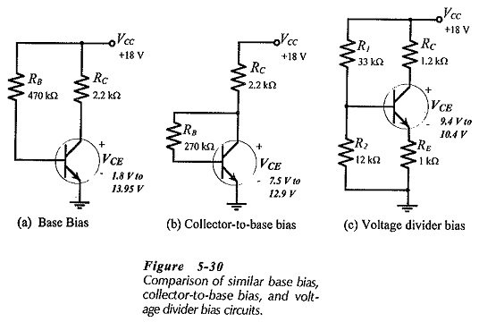
TYPES OF BIASING CIRCUITS
FIXED BIAS
VOLTAGE DIVIDER BIAS
COLLECTOR TO BASE BIAS

Slide 3
FIXED BIAS
This form of biasing is also called Base Bias. the single power source (ie. battery) is used for both collector and base of transistor, although separate batteries can also be used.
VCC = IBRB + Vbe Therefore,
IB = (VCC - Vbe)/RB
For a given transistor, Vbe does not vary significantly during use. As VCC is of fixed value, on selection of RB, the base current IB is fixed. Therefore this type is called fixed bias type of circuit.
Also for given circuit,
VCC = ICRC + Vce
Therefore,
Vce = VCC - ICRC
From this equation we can obtain Vce. Since IC = ßIB, we can obtain IC as well. In this manner, operating point given as (VCE,IC) can be set for given transistor.

Slide 4
Merits and Demerits
Merits:
It is simple to shift the operating point anywhere in the active region by merely changing the base resistor (RB).
Very few number of components are required.
Demerits:
The collector current does not remain constant with variation in temperature. Therefore the operating point is unstable.
When the transistor is replaced with another one, slight (if not large) change in the value of ß can be expected. Due to this the operating point will shift.

Slide 5
Usage:
Due to the above inherent drawbacks, fixed bias is rarely used in linear circuits, ie. those circuits which use the transistor as a current source.
Instead it is often used in circuits where transistor is used as a switch

Slide 6
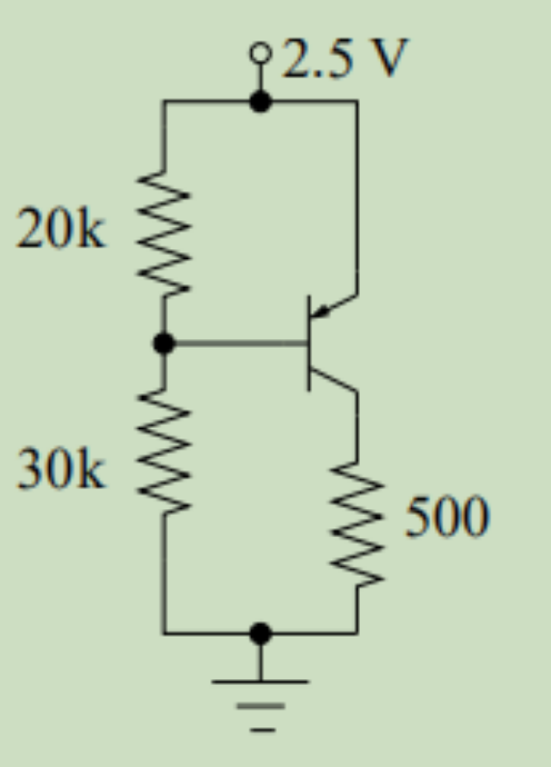
Numericals
Q1.Find the bias point of the transistor (Si BJT with β = 100)

Slide 7
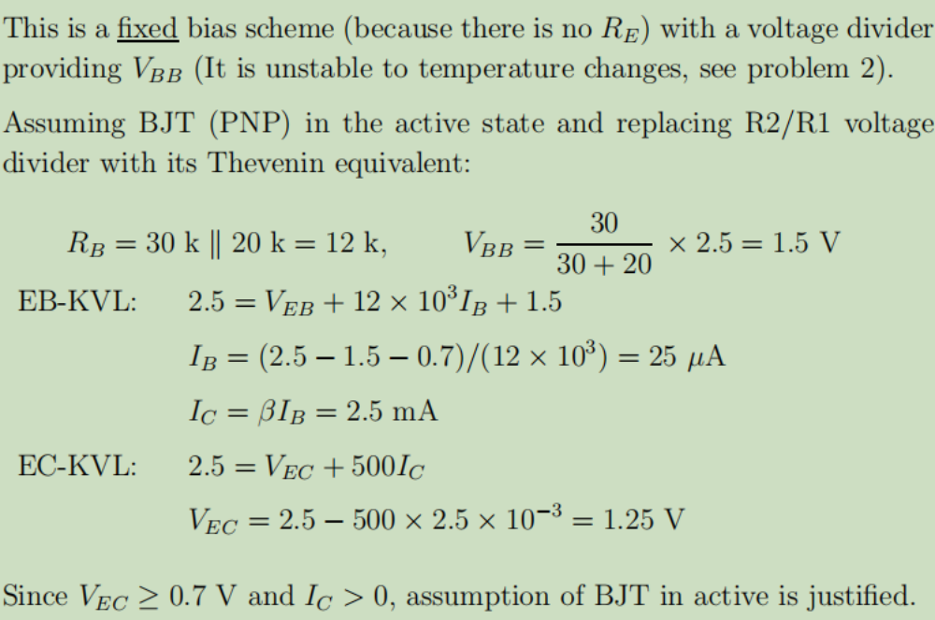
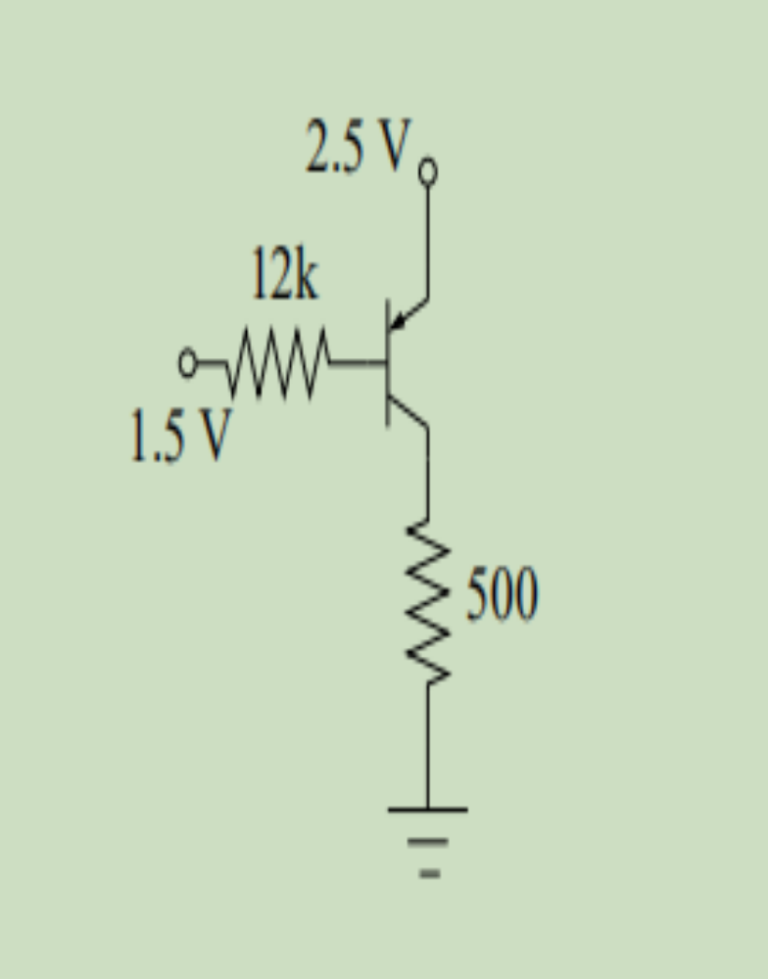
solution:

Slide 8
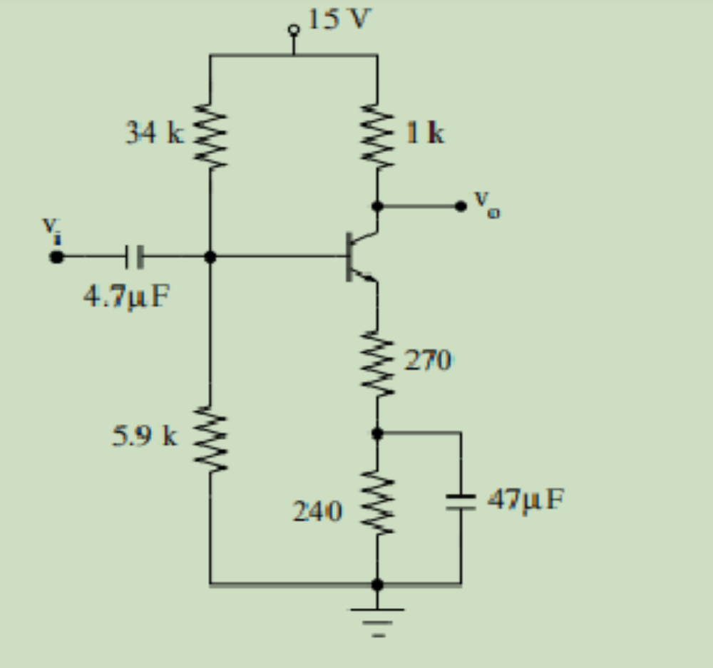
Q2.Find the bias point (Si BJT with β = 200)

Slide 9
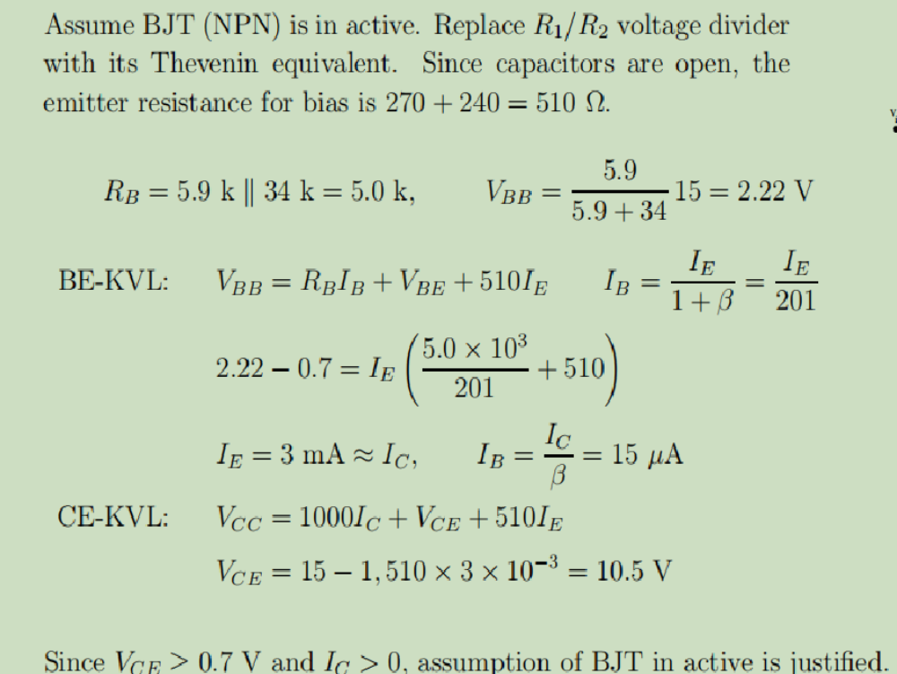
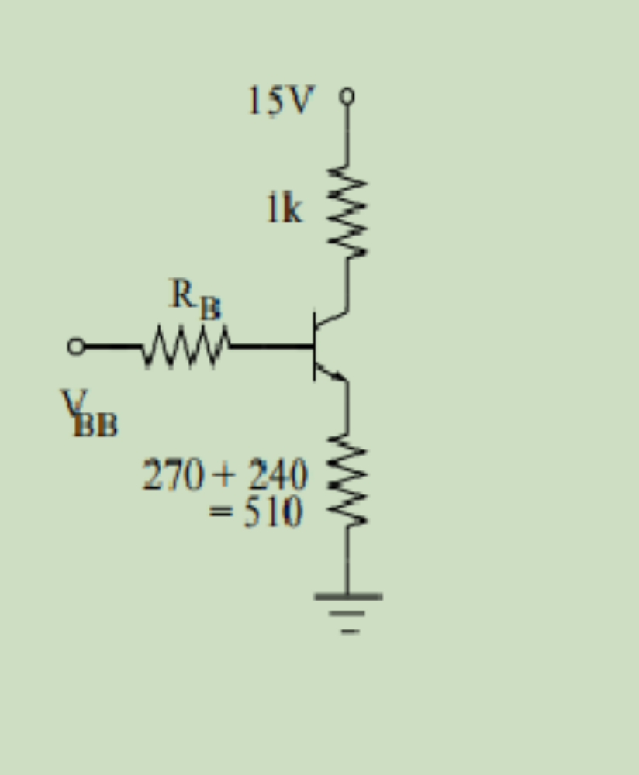
SOLUTION:

Slide 10
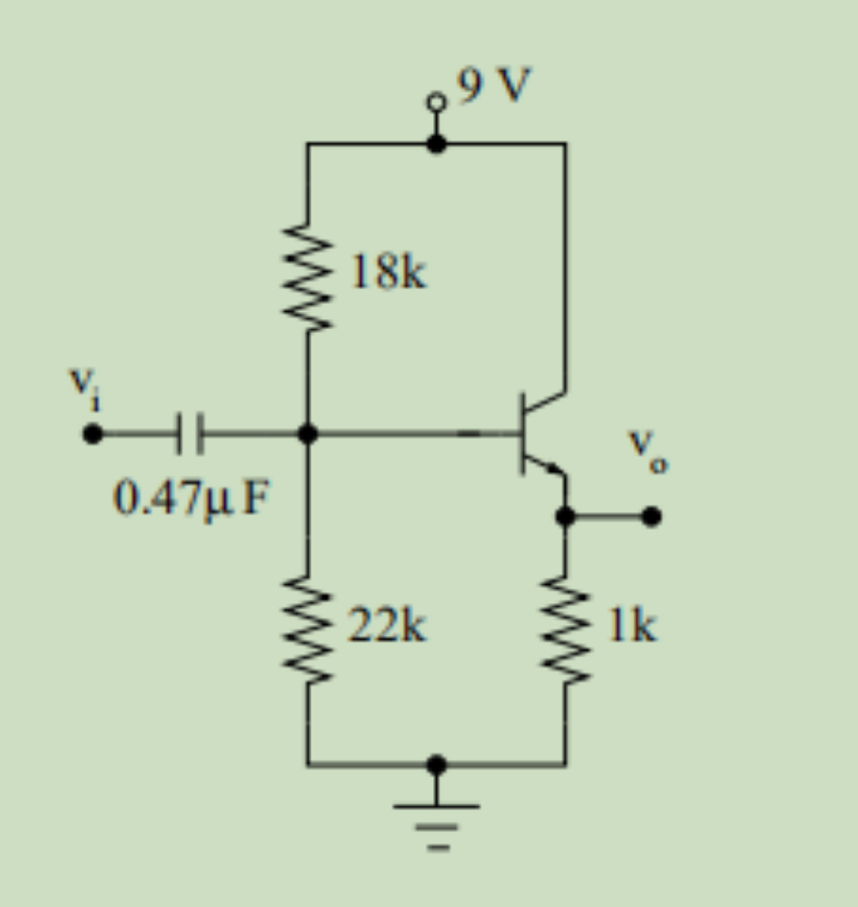
Q3.Find the bias point (Si BJT with β = 200)

Slide 11
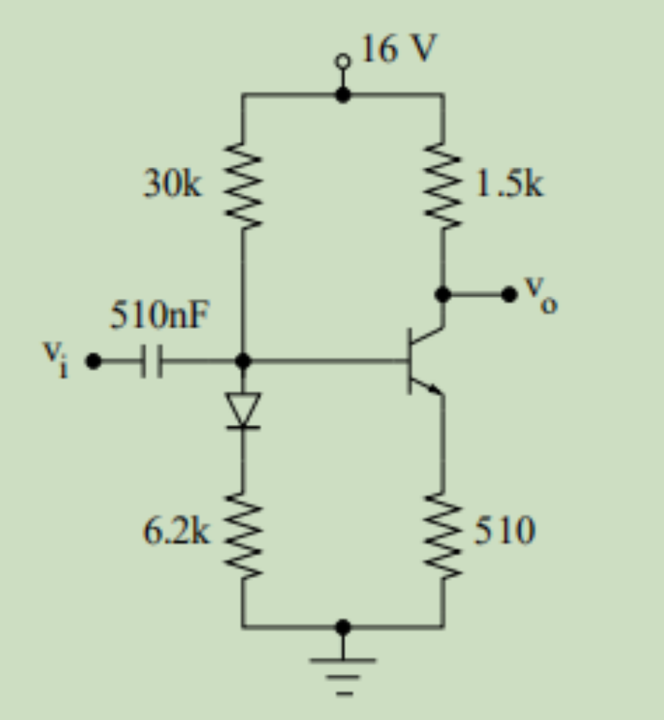
Q4.Find the bias point (Si BJT with β = 200)

